Slide 1
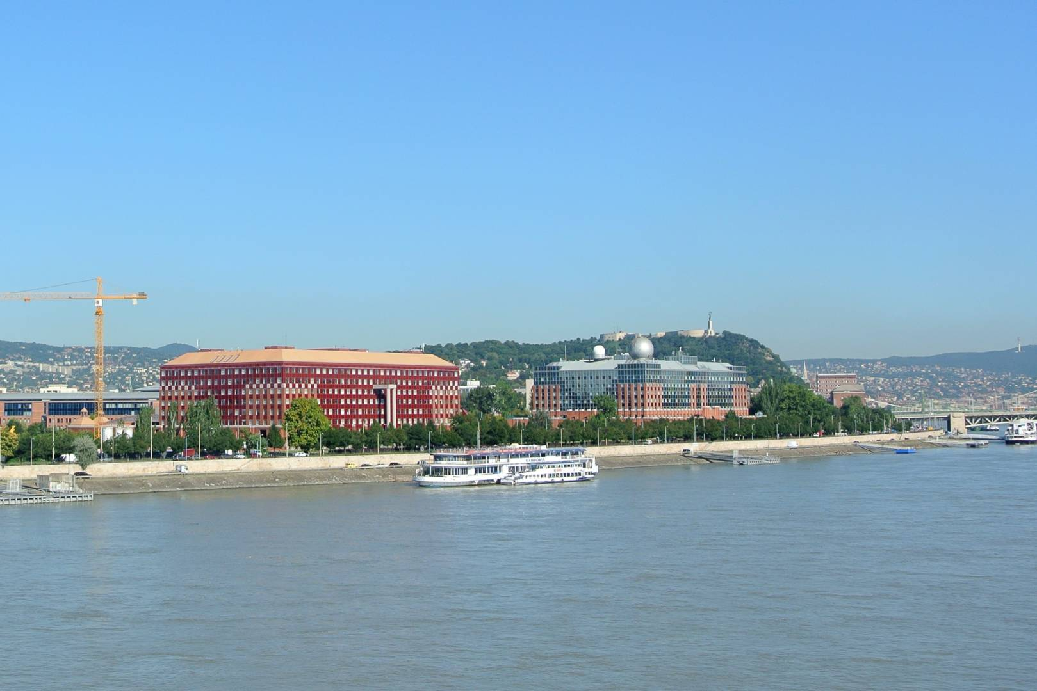
We work at ELTE
Supervisor: Prof. Tamas Vicsek
Co-supervisor: Dr. Balint Szabó
About ELTE: Predecessor established in 1635.
Recently, a new campus has been built on the scenic banks of the Danube. This campus, Lágymányos Campus is now home to three faculties: Faculty of Informatics, Faculty of Science, and Faculty of Social Sciences
ELTE campus of faculties of sciences

Slide 2
Tamas Vicsek
http://hal.elte.hu/~vicsek
Tamas Vicsek is an emeritus Professor of Physics at the Biological Physics Department of Eotvos . Over the past 40 years he has been involved in doing computational and experimental research on fractals, pattern formation, granular materials, collective motion (bacterial colonies, flocks, crowds, drones) and the and structure and evolution of complex networks. He is a winner of several prestigious prizes including the 2020 Lars Onsager prize of American Physical Society.
Google Scolar: over 50,000 citations
Experiment, segregation of cells
Simulation of escaping people

Slide 3
Bálint Szabó
http://balintszabo.web.elte.hu/
Ide majd írod, amit gondosz
Valamint javasolnék ábrát is

Slide 4
Inflammation is an exciting and important phenomenon
Our motivation for being part of the consortium efforts is based on our experience in simulation of cellular processes as well on our intention to obtain a better insight into the field.
We hope to receive interesting, unique related data and provide models that explain them in terms of simulations reproducing the observed behaviours

