Slide 1
Origins of hierarchical cooperation
Tamás Vicsek
Dept. of Biological Physics, Eötvös University, Hungary
http://hal.elte.hu/~vicsek
with: Zs. Ákos
B. Pettit (Oxford)
D. Biro (Oxford)
E. Mones
M. Nagy
T. Nepusz
L. Vicsek
A. Zafeiris
EU FP7 Hung.Acad. Sci. Eötvös Univ.

Slide 2
Motivation I
Complex sytems are hierarchical. Hierarchy is abundant, but no widely accepted quantitative interpretation of the origin and emergence of multi-level hierarchies exist
Motivation II (Pigeons)
In a recent work we observed that during collective decision making, (i.e., navigating home as a single group), pigeons choose their common direction of flight as a result of dynamically changing hierarchical leadership-followership interactions.
They also behave accoording to an order-hierarchy type dominance hierarchy in their loft

Slide 4
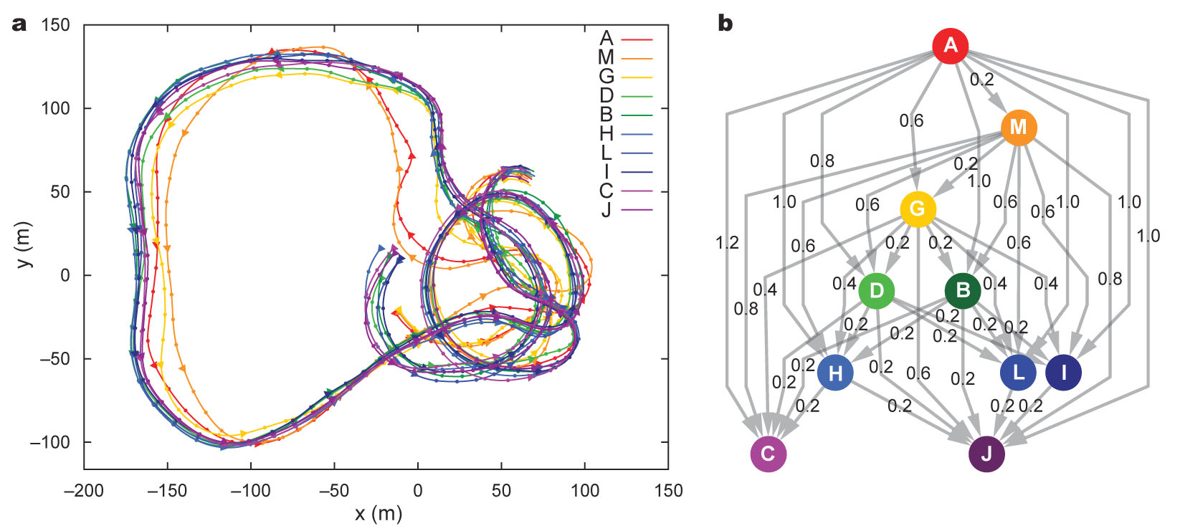
Hierarchical leadership network generated for a single flock flight. a, 2-minute segment from a free flight performed by a flock of ten pigeons. Dots and triangles indicate every 1s and 5s, respectively; triangles point in the direction of motion. Letters refer to bird identity. b, Hierarchical network of the flock for the flight shown in panel a. For each pairwise comparison the directed edge points from the leader to the follower; values on edges show the time delay (in seconds) in the two birds’ motion.

Slide 5
Digital video analysis of the moving pigeons around the feeding cup

Slide 6
Pairwise dominance graph as determined from „who is closer to the feeding cup”
„context dependent” (i.e., very different from navigational)

Slide 7
What are the main signatures of hierarchy (and such networks)?
Open question (order, embedded, flow, a mixture of these, measures of the level of hierarchy)
How do they emerge?
Open question
What are the main features optimized by hierarchy?
Flow of information? * More efficient production? Controllability?? Better decision making process? *

Slide 8
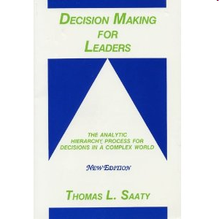
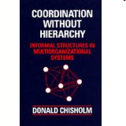

Slide 9
Hierachy Measure for Complex Networks
With E. Mones and L. Vicsek
There exsists no widely applicable/accepted measure
for the level of hiararchy
The measure we are looking for should not depend on any arbitrary parameters, or a priori metrics.
It should be useful for visualization purposes as well.

Slide 10
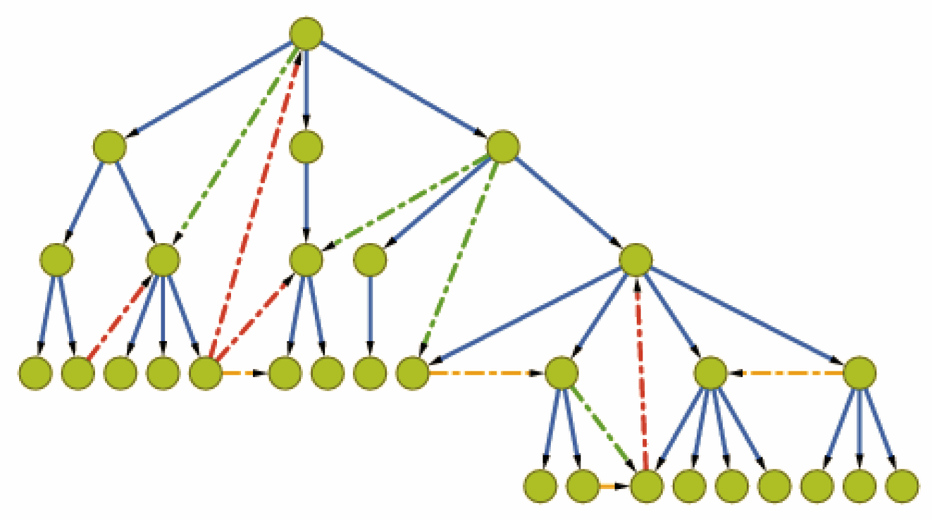
Local reaching centrality: The number of nodes reachable from the given node
Tests on a model graph with tunable hierachy
Start from tree and add edges so that a p percent of them
points „downward”

Slide 11
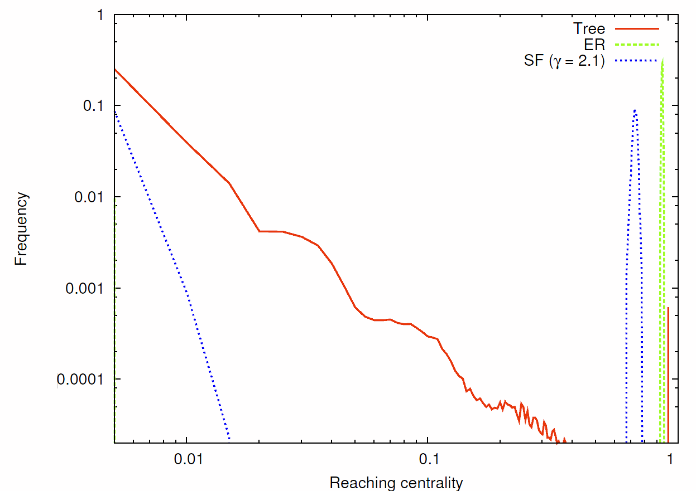
Distribution of local reaching centralities

Slide 12
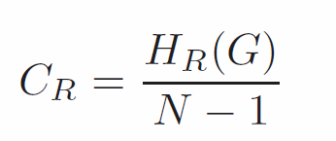
Local and global reaching centralities
Local: number of nodes accessible from node i
Global
normalized

Slide 13
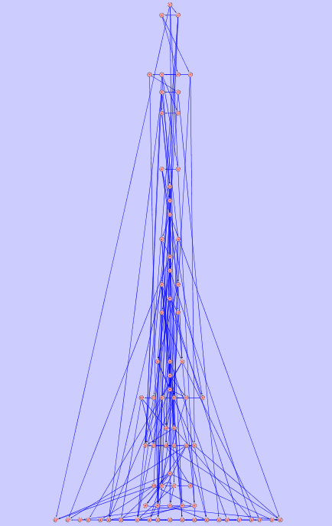
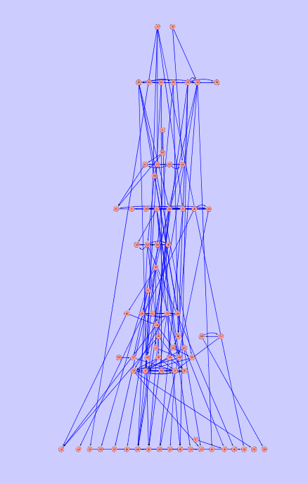
Visualization of the hierarchical structure of a network
with an intermediate level of hierarchy
(based on reaching centrality)
„Syntethic” experiment

Slide 14
The case of optimal order hierarchy:
Group performance is maximized by hierarchical competence distribution
Our results were obtained by optimizing the group behaviour of the models we introduced through identifying the best performing distributions for both the competences (level of contribution to the best solution) and for the members’ flexibilities/pliancies (willingness to comply with group mates).
Potential applications include choosing the best composition for a team, where „best” means better performance using the smallest possible amount of resources („competence costs money”)

Slide 15
One of our main observations/statements is that most of the tasks to be completed during collective decision making can be reduced to an “estimation” (of the best solution) paradigm.
We consider the following general situation: finding the best solution happens in rounds of interactions during which
- each individual makes an estimation of the best solution based on its competence
(ranging from small to very good), and from the behaviours of its neighbours
(neighbours being represented by nodes of various networks).
- the actual choice of the members also depends on their varying flexibilities
(pliancies, i.e., the level to which they are willing to adopt the choices of
their neighbours)
a collective “guess” about the true solution is made
(then a new round starts)

Slide 16
Thus, we defined four generic Group Performance Maximization Models.
Because of the simplicity of our GPMMs, many real-life tasks can be mapped on each of them. The quality of the groups’ performance, Pe, is quantifiable and characterized by a parameter with values in the [0, 1] interval.
Individual _{i} has a competence level Co_{i}. Co_{i} also takes values from the [0, 1] interval. Each model/game consists of iterative steps. (i) The behaviour Be_{i}(t+1) of agent (member) i at time step t+1, depends both on its own estimation f(Co_{i}) regarding the correct solution, and on the (observable) average behaviour of its neighbours j(ϵR) in the previous step t, <Be_{tj}>jϵR:
Be_{i}(t+1) = (1-λ_{i}) f(Co_{i}) ‘+’ λ_{i}<Be(t)_{j}> jϵR,
where ‘+’ denotes “behaviour-dependent summation”, and “behaviour” refers to various actions, such as estimating a value, casting a vote or turning into a direction, etc. The set of weight parameters λ_{i} takes values on the [0, 1] interval and defines the pliancy distribution.
F = Pe – K<Co>,
Optimal distribution of competences is determined by maximizing the fitness F using a genetic algorithm

Slide 17
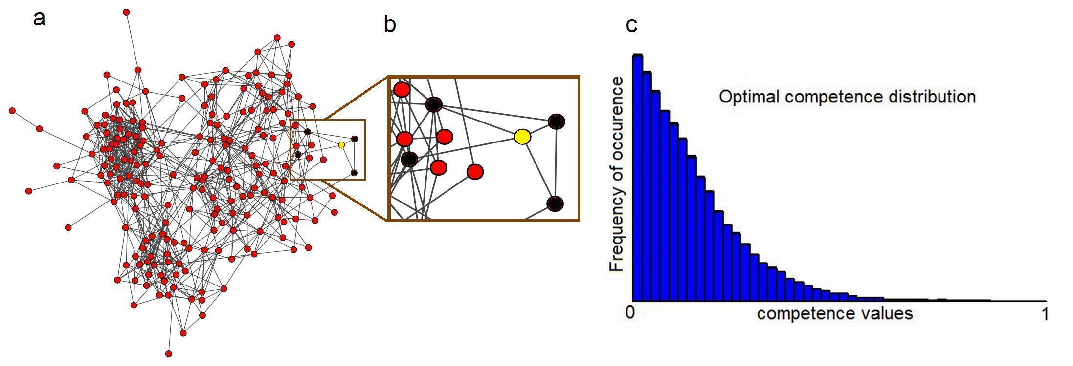
Voting model
Simplest: guess whether up or down is the true state
ask nearest neighbours
take majority vote
make one more round

Slide 18
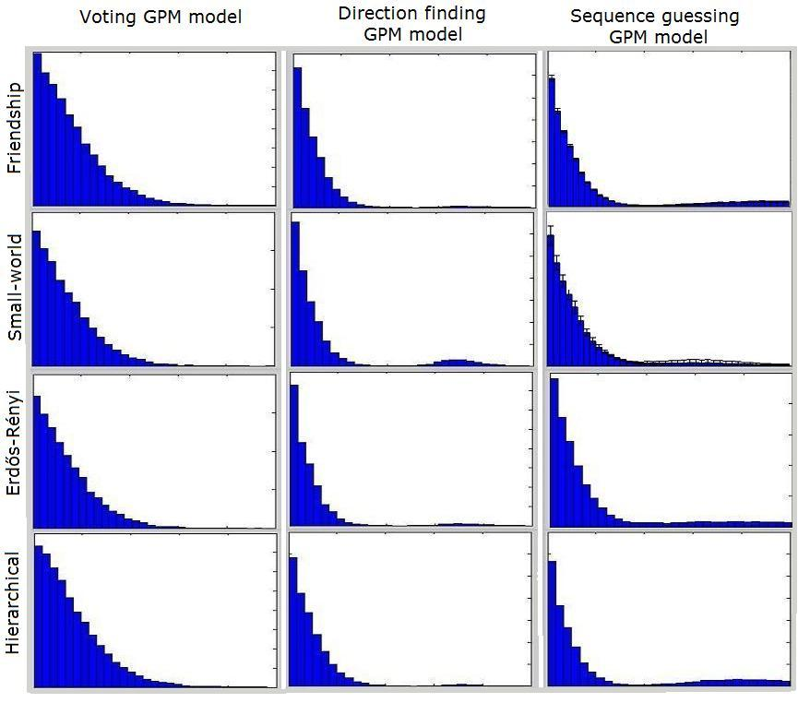

Slide 19
Number sequence guessing game on a small world graph

Slide 20
Homing pigeon flock model

Slide 21
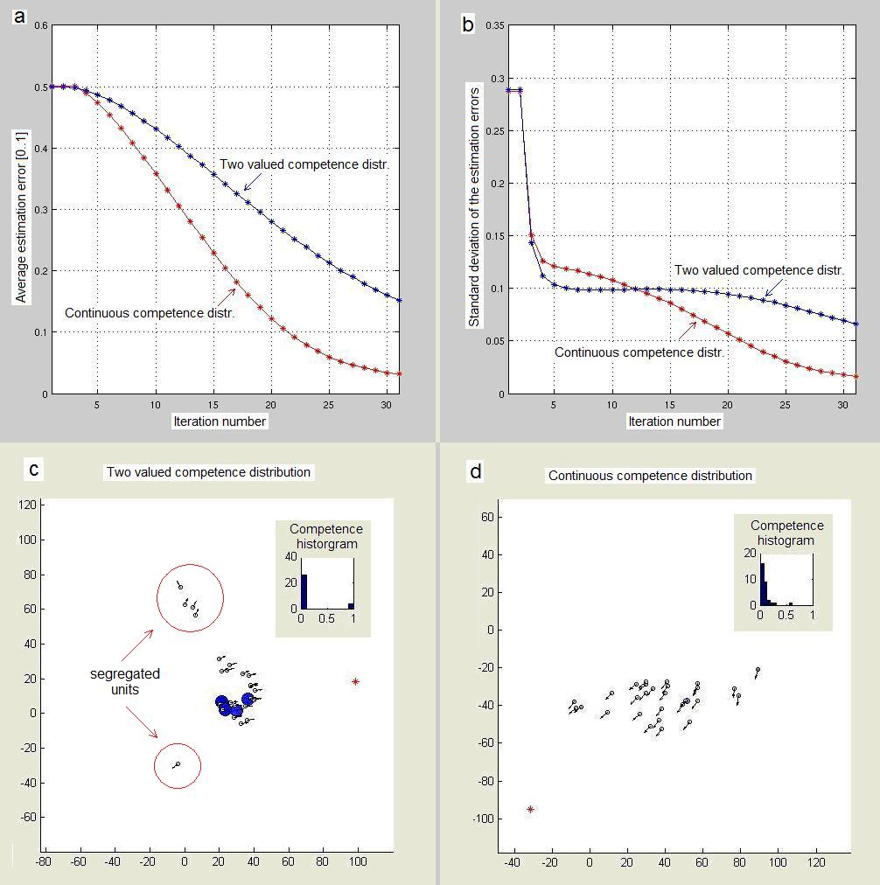
Interpretation: better mixing of the information
Sign of „segregation”

Slide 23
Emergence of hierarchical cooperation
among selfish individuals
Essential model parameters:
n – the number of agents
p – the probability of a state flip in the environment
a_{i} – the fitness score of agent i
Derived parameters
t_{ij} – the fitness score of agent j as estimated by agent i.
T – the matrix of fitness score estimates (i.e. T = [ t_{ij} ])

Slide 24
By building and investigating a simple model that spontaneously leads to hierarchical network-type organization we may make a significant progress towards getting a deeper insight into the hierarchy producing mechanisms. We have designed such a model, which due to its simplicity is applicable to a wide range of actual situations

Slide 25
What are the major factors driving a group of interacting selfish actors all trying to optimize their individual success?
the groups are embedded into a changing environment and better adaptation to the changes is one of the core advantages an individual can have
- importantly enough, the abilities of individuals to gain advantage from their environment is obviously diverse
individuals are trying to follow the decisions of their group mates (learn from them) in proportion with the degree they trust the level of judgment of the other actors as compared to their own level of competence
Quite remarkably, when these basic and natural assumptions are integrated into a game theoretical-like stochastic model, the process results in the emergence of a collaboration structure in which the leadership-followership relations manifest themselves in the form of a multi-level, directed hierarchical network.

Slide 26
The rules can be formulated as follows:
1. First we define a changing environment (the state of which the individuals have to guess to gain benefit) as simple as possible, but still varying in an unpredictable way. The state of the environment is chosen to have a value of 1 or 0 with a probability p. Such a definition corresponds to a random walk with a characteristic time of changing its direction proportional to 1/p
2. The individuals have a pre-defined ability (according to a given distribution with values between 0 and 1) to make a proper guess of the state of the environment. Their guess in each turn is based on their interactions with the agents they trust the most by making a weighted average of the decisions of the most trusted k=1,2 ..m friends/colleagues/players and his/her own estimate.
3. The trust matrix is thus used to update the guess of a player in the next round (the elements of this matrix correspond to the degree agent i trusts agent j). Individuals are trusted on the basis of their prior performance. More trusted agents are „listened to” more frequently. Naturally, the trust matrix is updated as the collective decision making process progresses.
4. A network is constructed based on the frequency of how many times agent i takes into account the guess of agent j.
(the actual realization/algorithm has a few more less relevant rules)

Slide 28
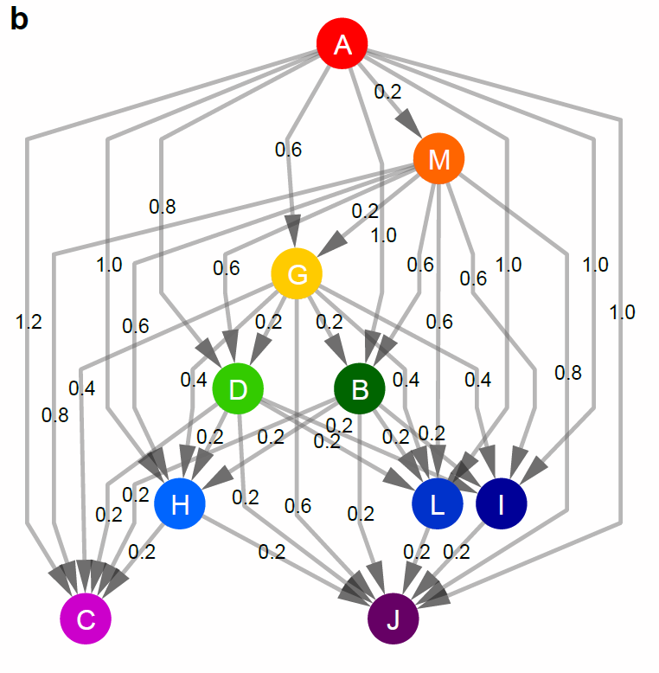

Slide 31
Leadership-followership relations in an experiment with
86 participants on gaining the most virtual money in an
economics „game” (Liskaland camp)

Slide 33
Hierarchy is spontaneously built up. The average successful guess of an agent within the network significantly exceeds its own average success without interacting with the others.
Although asking always (by every player) the agent who has the highest ability would be the optimal solution, the system does not arrive at this solution in a reasonable time for two reasons:
i) The agents do not know at the very beginning the ability of the other agents (they learn about it due course)
ii) as the system evolves, it first builds up a hierarchical network of trusted connections (a collective of leaders and followers on many levels). However, the system has a very strong tendency to become trapped in a „locally” optimal structure. Reorganizing would involve a sequence of temporarily much less optimal structures.

Slide 34
The end (temporarily)

Slide 35
Thanks!

